Slide 1
Micro Credit Project
Submitted by:
Kaushik Kalappa

Slide 2
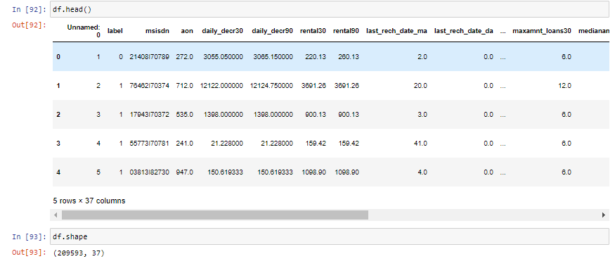
This is the screenshot of how the data frame looks like with the data size of 209593 rows and 37 columns

Slide 3
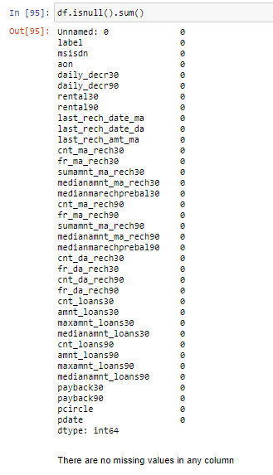
There are no null or missing values in the dataset

Slide 4
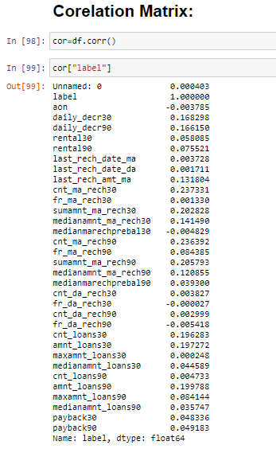
This is the corelation of all the columns with the label target variable

Slide 5
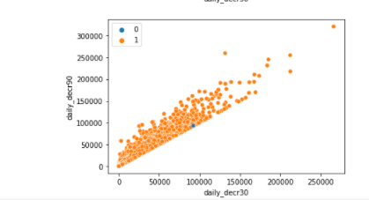
Bivariate analysis:
daily_decr30 has a linear relationship with daily_decr90 but unbale to segregate label values

Slide 6
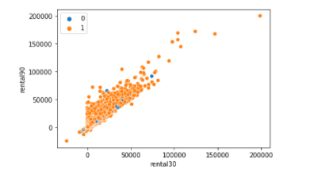
rental30 has a linear relationship with rental90 but unbale to segregate label values

Slide 7
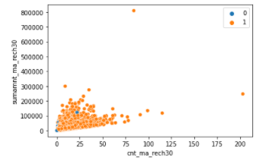
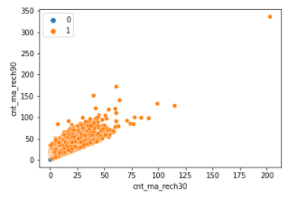
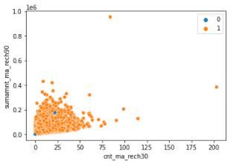
cnt_ma_rech30 has a linear relationship with sumamnt_ma_rech30 but unbale to segregate label values
cnt_ma_rech30 has a linear relatiionship with cnt_ma_rech90
cnt_ma_rech30 has a linear relationship with sumamnt_ma_rech90 but unbale to segregate label values

Slide 8
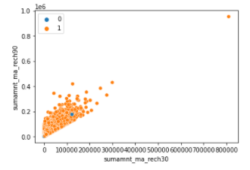
sumamnt_ma_rech30 has a linear relatiionship with sumamnt_ma_rech90

Slide 9
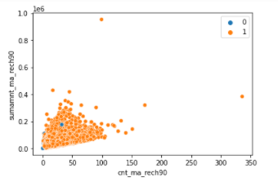
cnt_ma_rech90 has a linear relationship with sumamnt_ma_rech90 but unbale to segregate label values

Slide 10
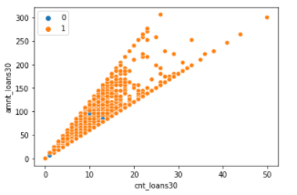
cnt_loans30 has a linear relationship with amnt_loans30 but unbale to segregate label values

Slide 11
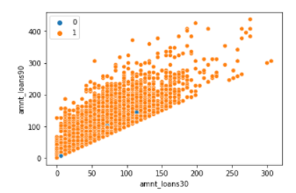
amnt_loans30 has a linear relatiionship with amnt_loans90 but unbale to segregate label values

Slide 12
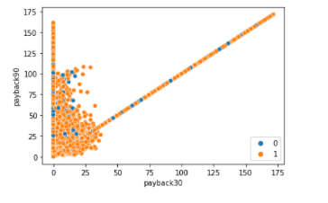
payback30 has a linear relationship with payback90 but unbale to segregate label values

Slide 13
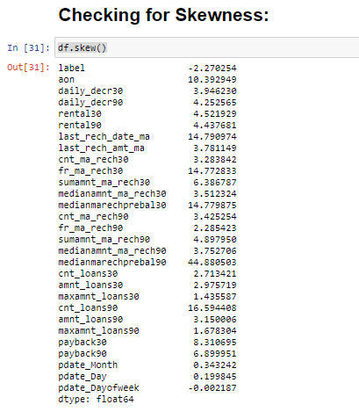
After dropping irrelavant columns and adding new columns as a part of feature engineering, above is how the skewness looks like .

Slide 14
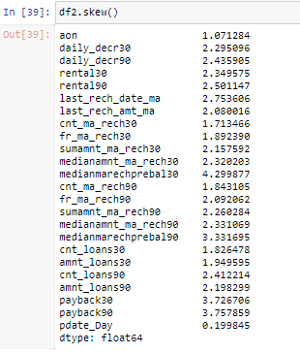
This is how the skewness looks like after replacing the top one percent Outliers with Upper limits

Slide 15
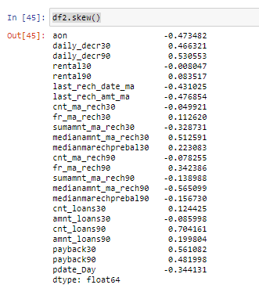
This is how the skewness looks like after removing the applying the best log transformations for the particular columns

Slide 16
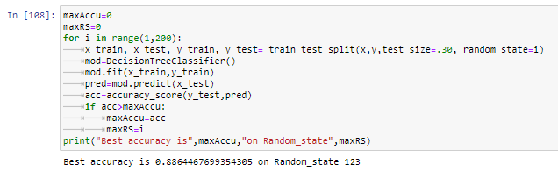
After the train test split the best random state was spottted at 123

Slide 17
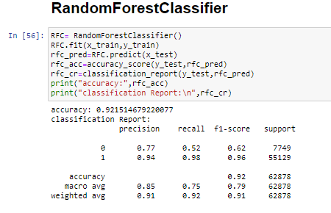
After applying different models Random Forest Classifier came out as a top model in terms of accuracy, cross validation score and classification report metrics

Slide 18
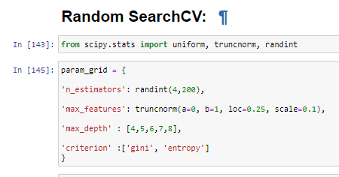
The above are the parameters for Hyper Parameter tuning using Random Search CV

Slide 19
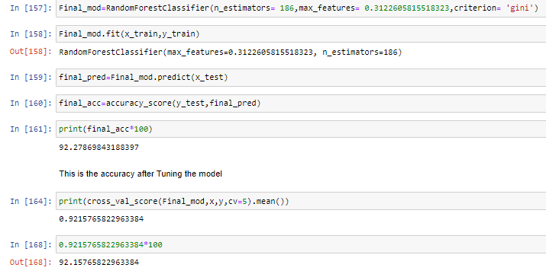
This is the final accuracy and Cross Validation Score of the Random Forest Classifier after tuning the model

